Slide 1
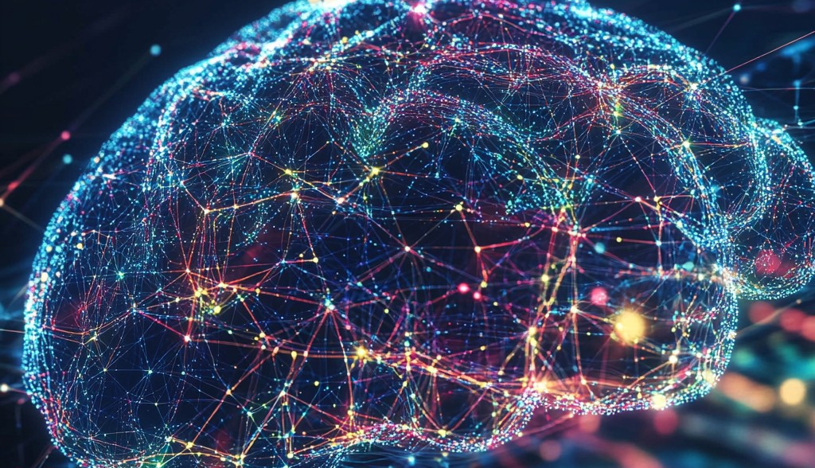
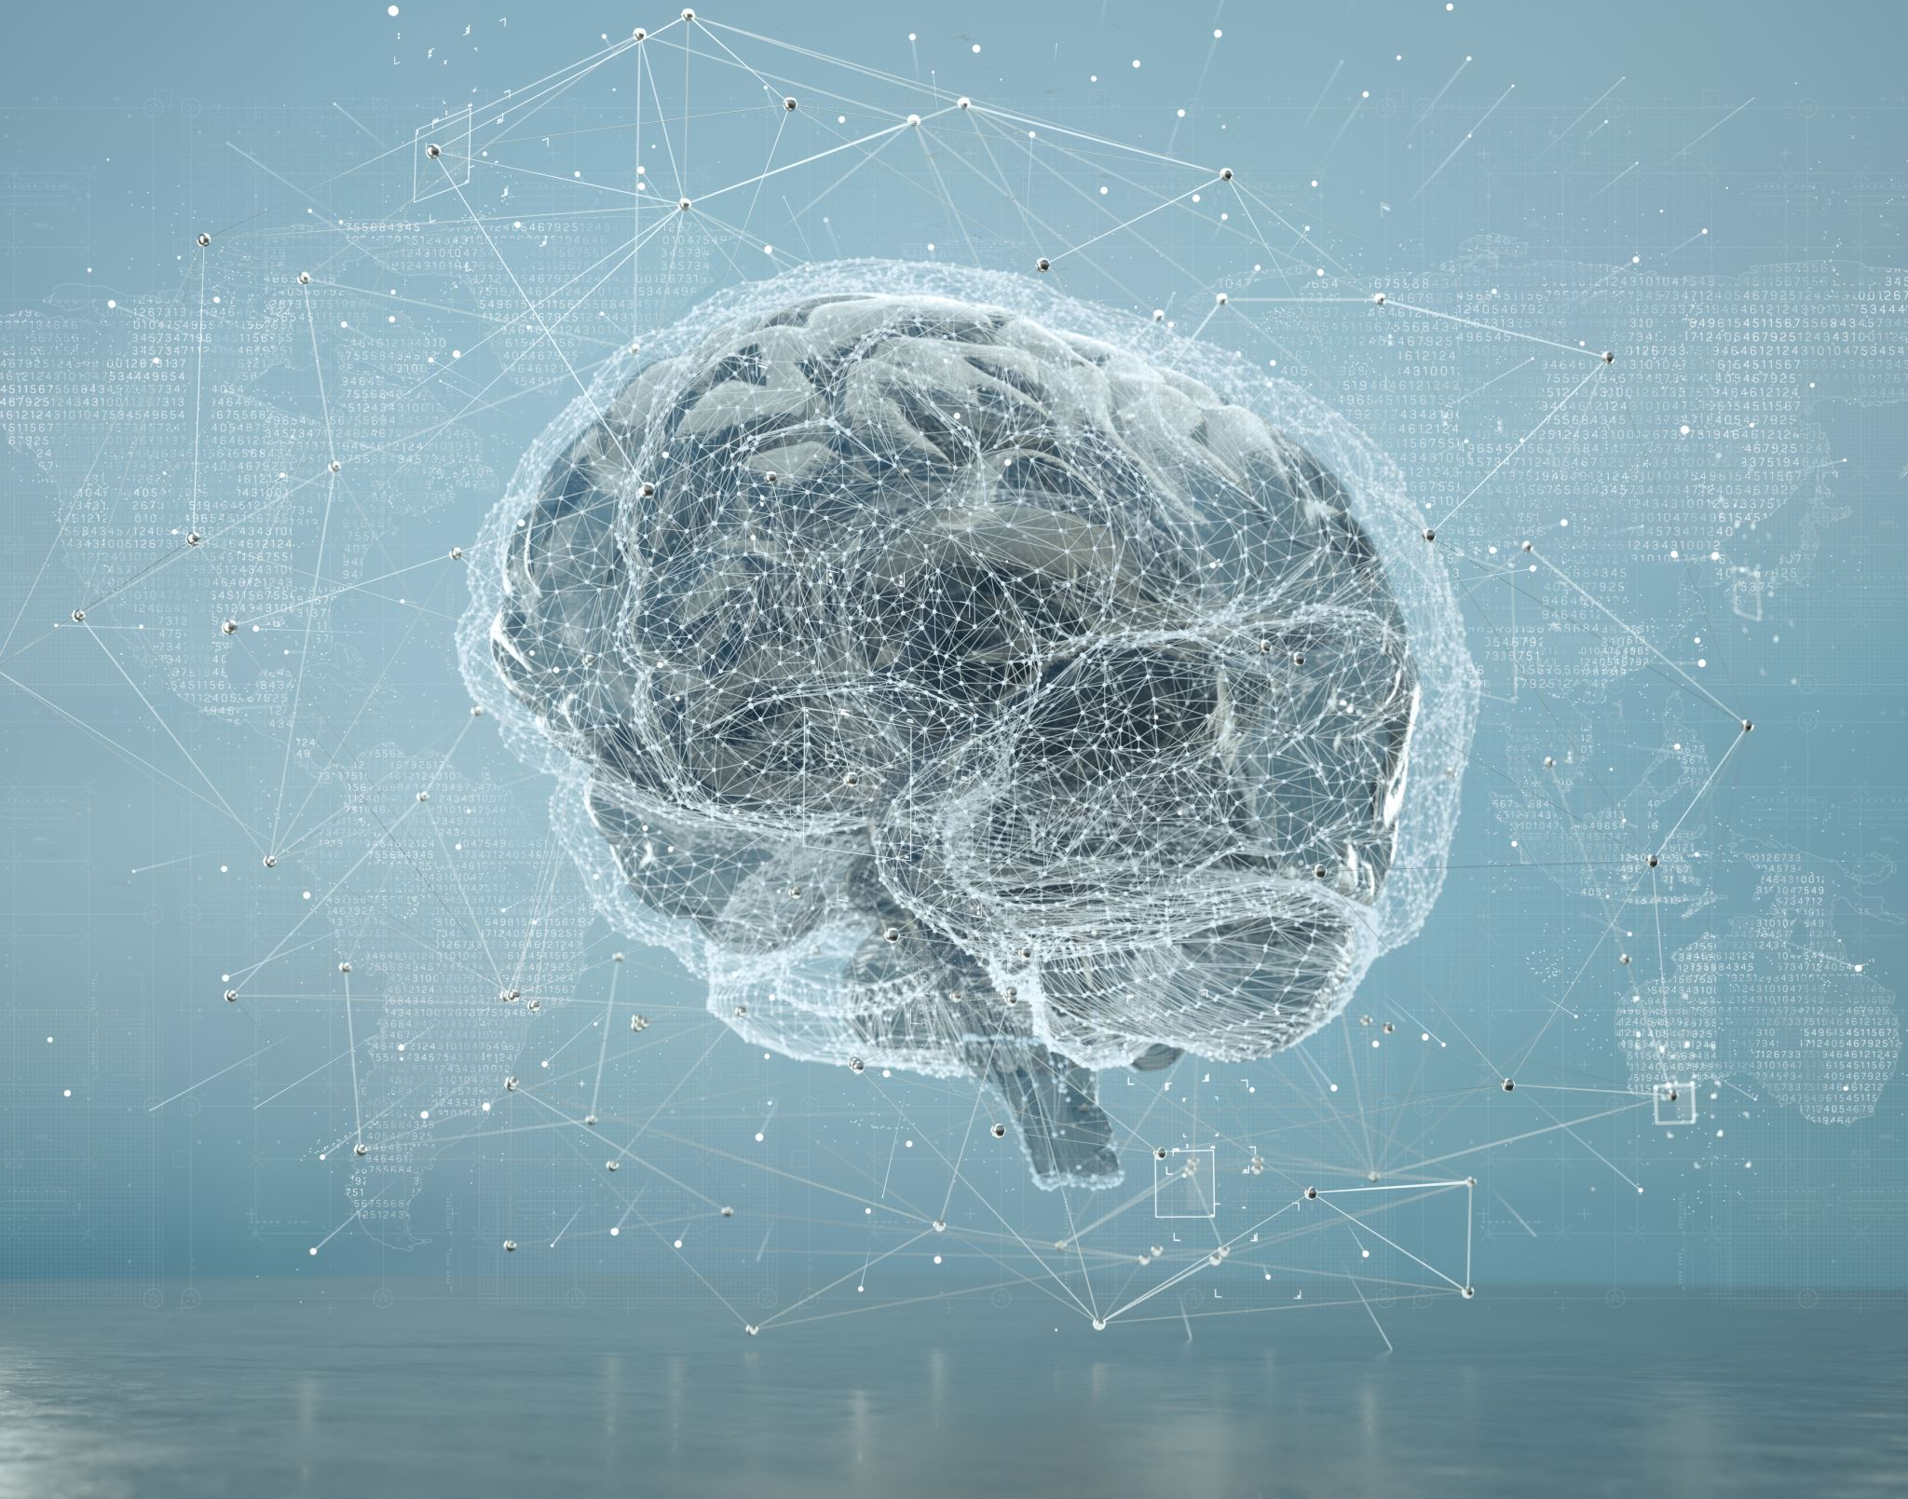
Neuro-Inspired Deep Learning
Harnessing Neural and Cognitive Principles for Advancing AI Architectures and World Modeling
Roy Levy
Guided by Dr. Maya Herman

Slide 2
How can machines learn as efficiently as humans and animals?
Architectures capable of advanced reasoning, planning, problem solving, understanding of the physical world?
What does nature’s hundred-million-year optimization algorithm have to teach us about intelligence?
More fundamentally, what is intelligence?

Slide 3
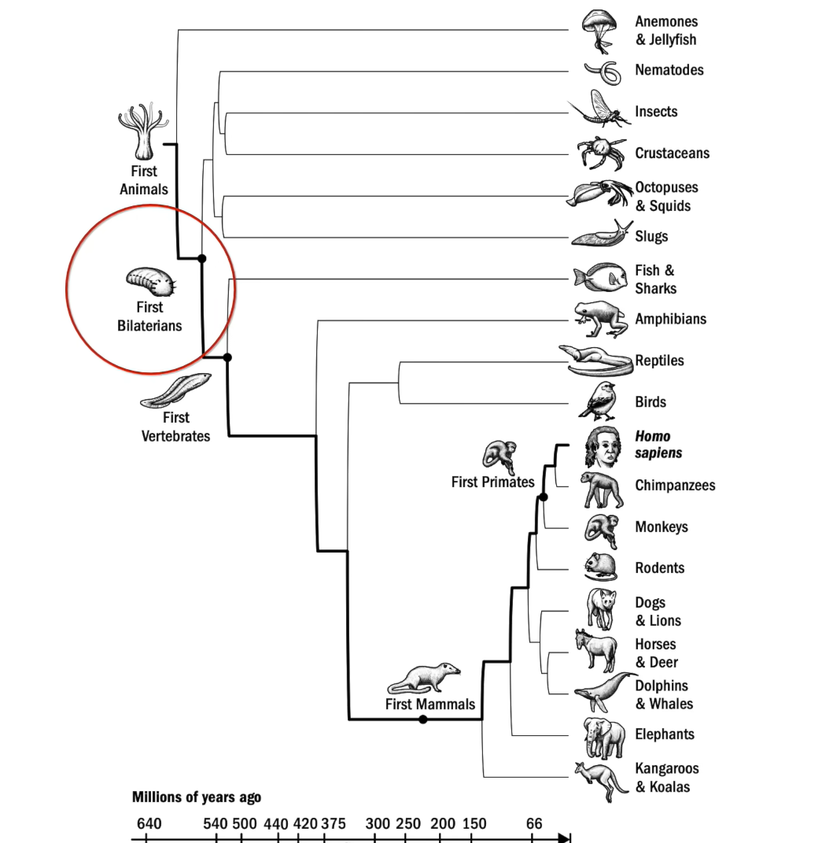
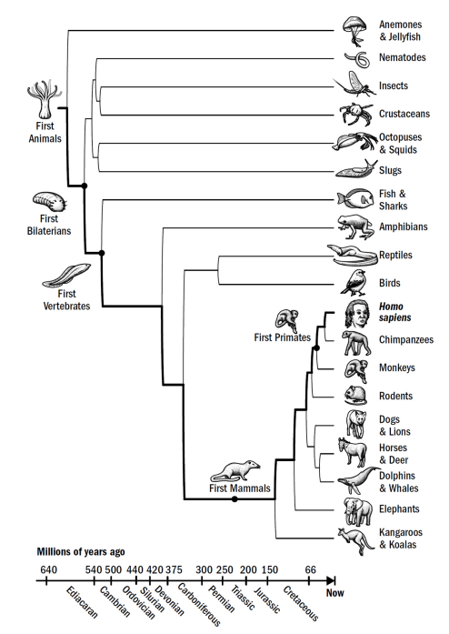
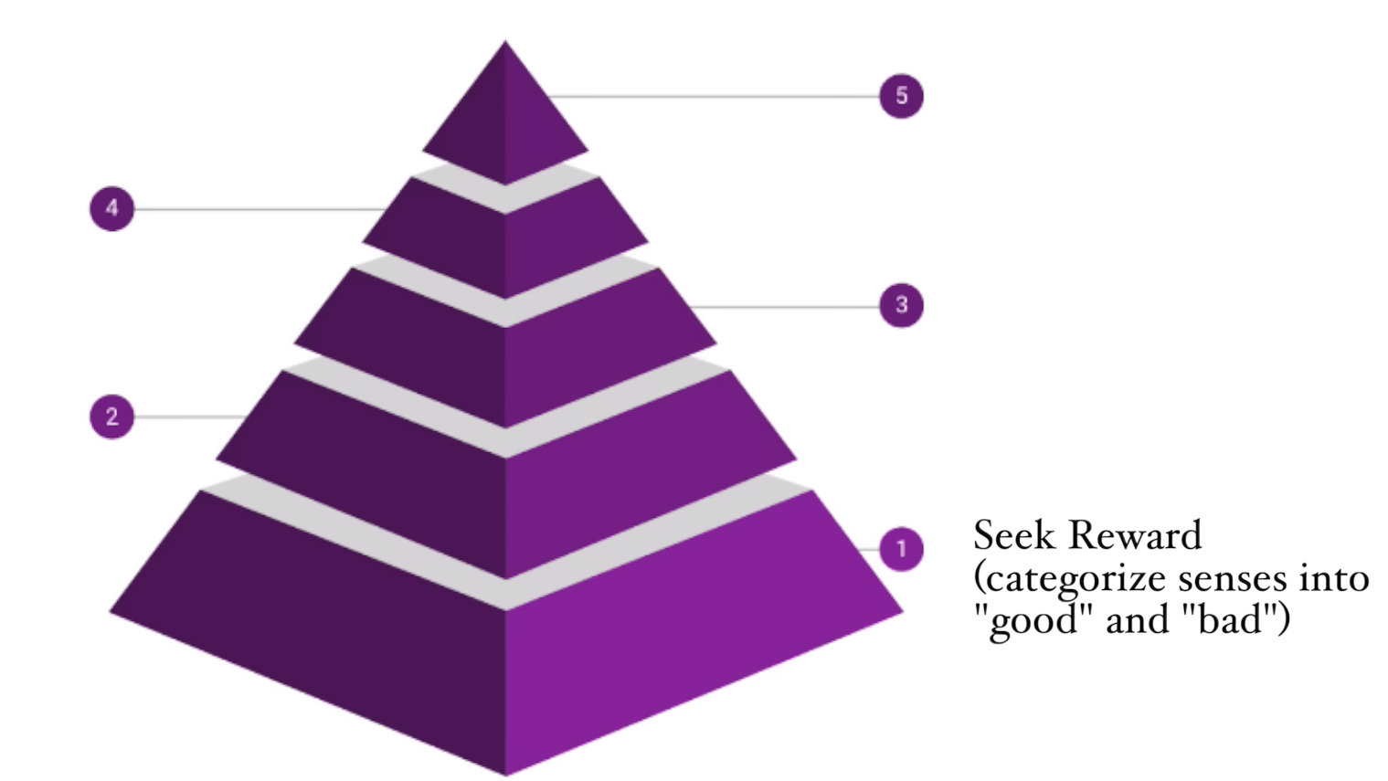
Foundations – Principles from Neuroscience and Brain Evolution
Steering – “positive valence” (approach)
and “negative valence” (avoid)

Slide 4
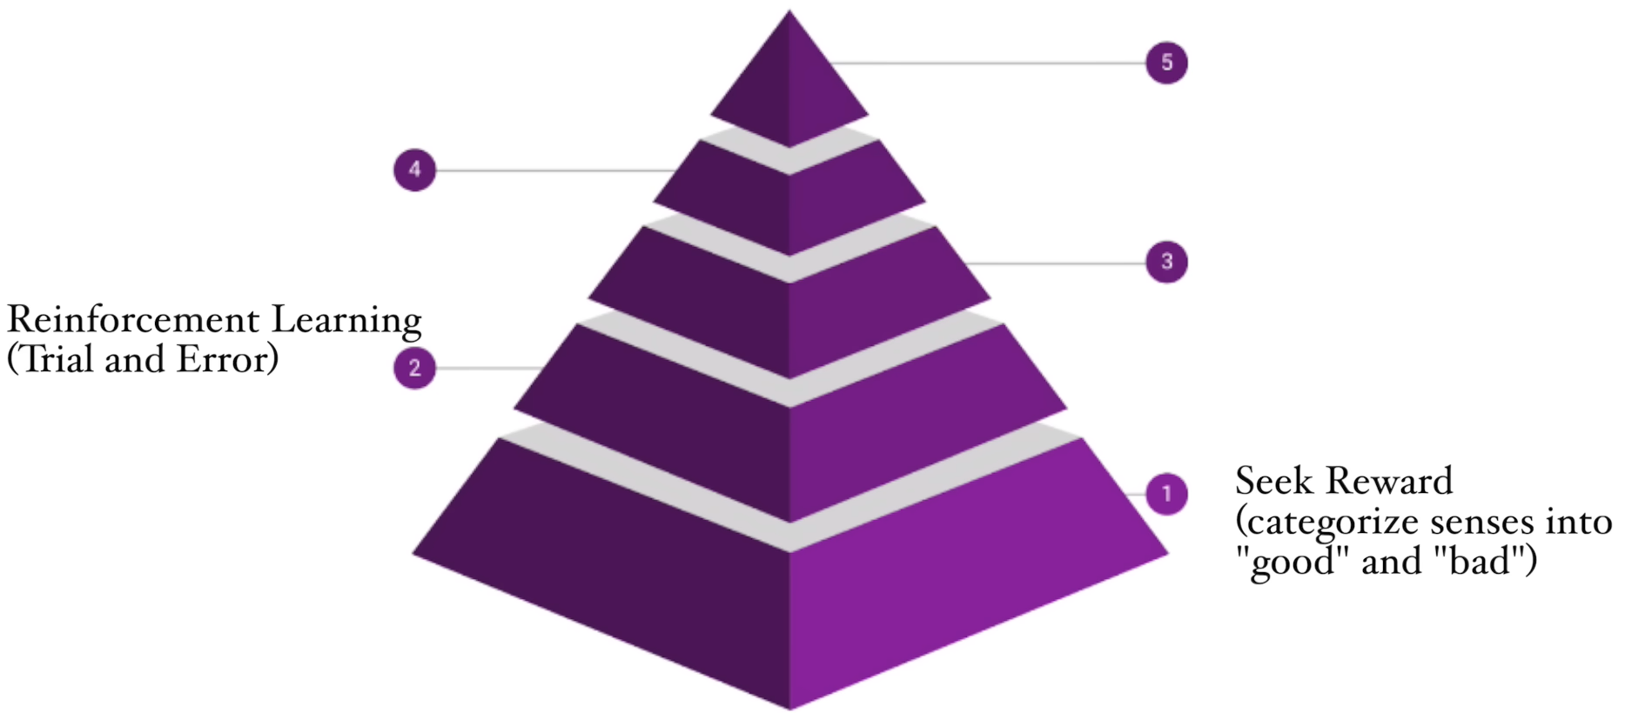
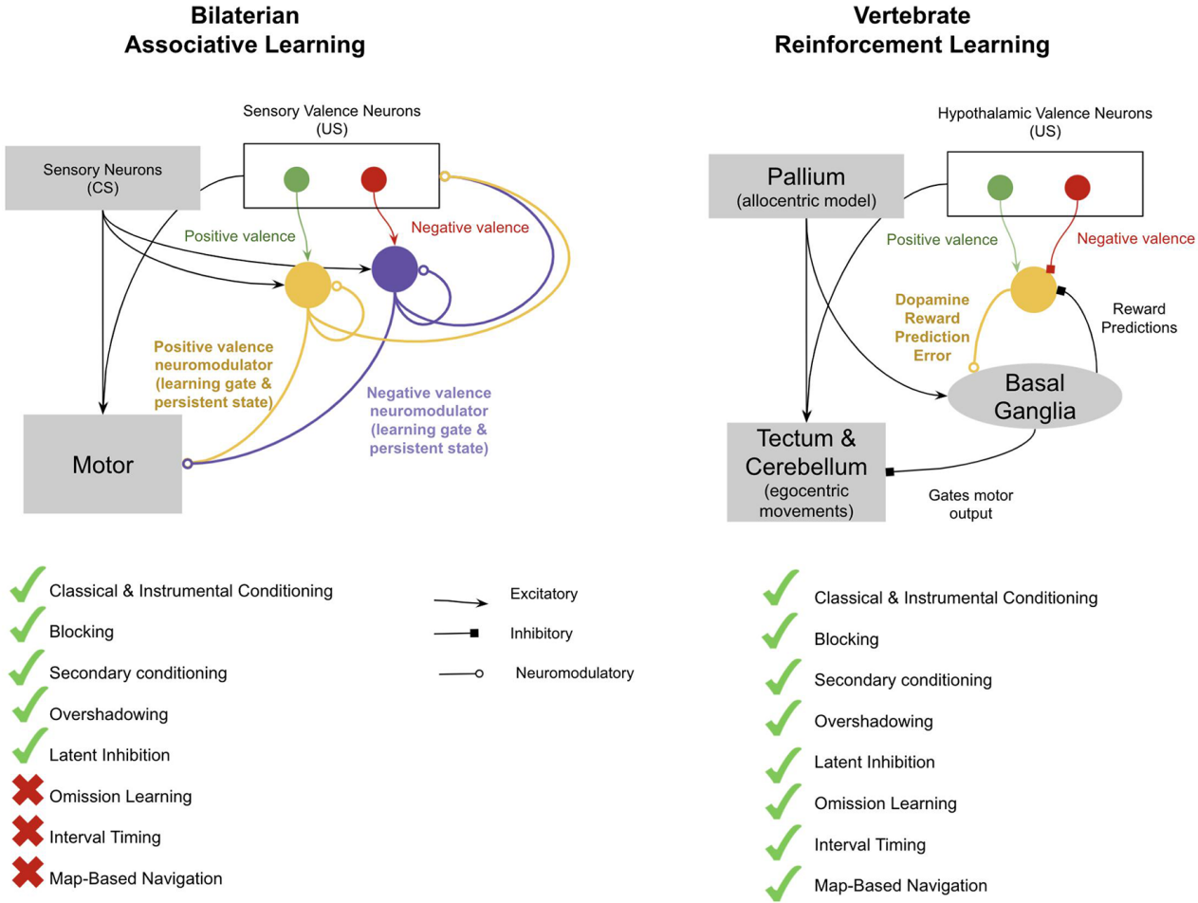
Foundations – Principles from Neuroscience and Brain Evolution
Reinforcing in early vertebrae
Model-free reinforcing
Pallium – “spatial map” and early perception
Basal ganglia – reward prediction
- Map-based navigation
- Interval timing
- Omission learning

Slide 5
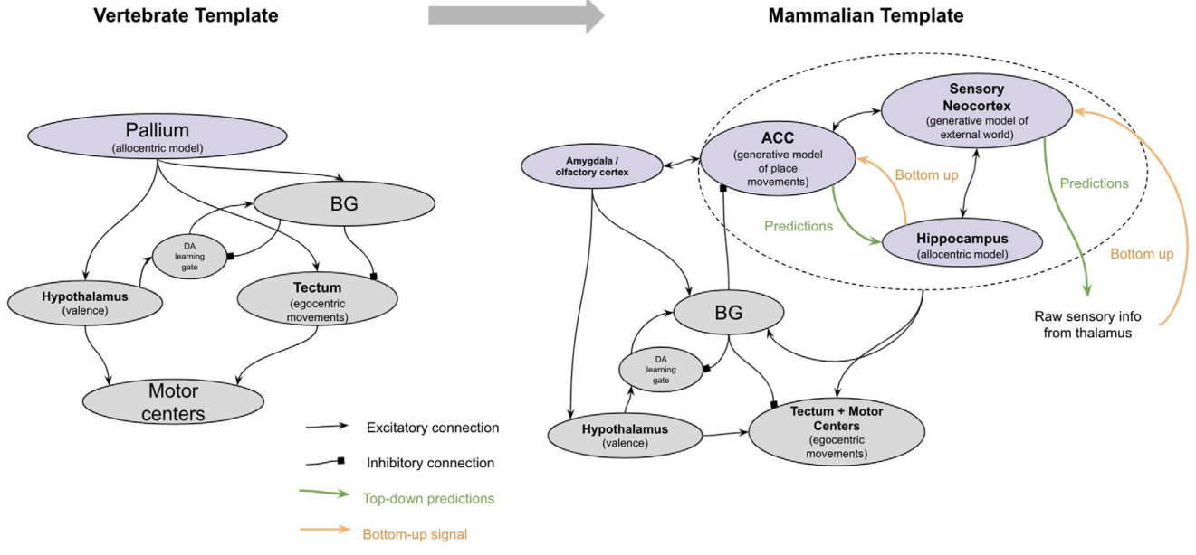
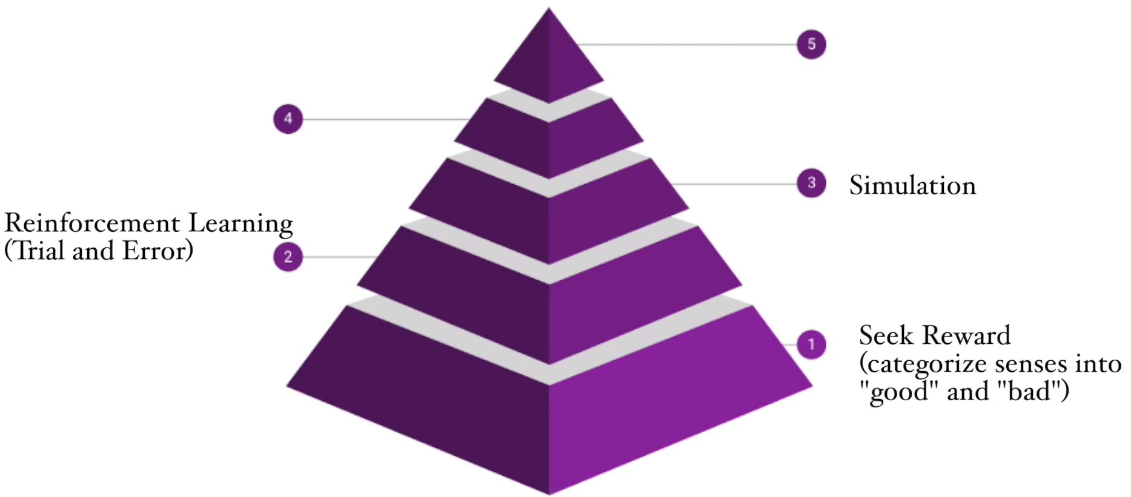
Foundations – Principles from Neuroscience and Brain Evolution
Simulating in early mammals
Neocortical columns – self supervised
Sensory cortex
Anterior cingulate cortex (ACC) – a latent model of intent
Vicarious trial and error (VTE; simulating imagined action sequences)
Counterfactual learning (simulating alternative choices)
Episodic memory (simulating past events)

Slide 6
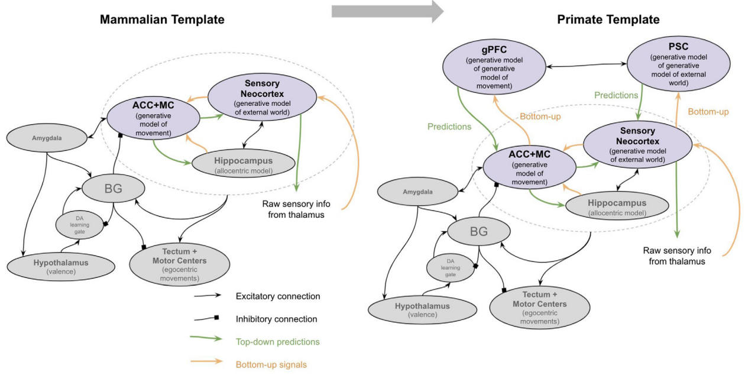
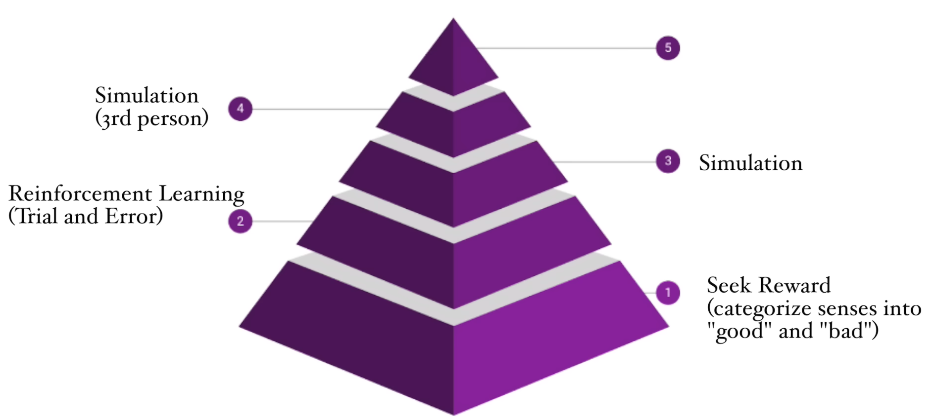
Foundations – Principles from Neuroscience and Brain Evolution
Mentalizing in early primates – to construct a model of the mind
Anticipating future needs
Theory of mind (“thinking about the thinking of others”, “thinking about one’s own thinking”)
Learning by observation
gPFC-PSC – a generative model of the ACC-sensory intent model
What intentions would be selected given such situations

Slide 7
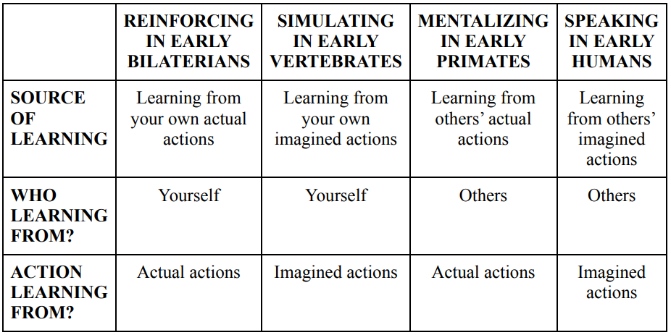

Foundations – Principles from Neuroscience and Brain Evolution
Language in humans
Symbols chained in sequences of any length to represent thoughts of any kind or complexity
Why only now?
Mentalization
- Inferring knowledge of others, and intent of oneself and others
- Synchronized communication

Slide 8
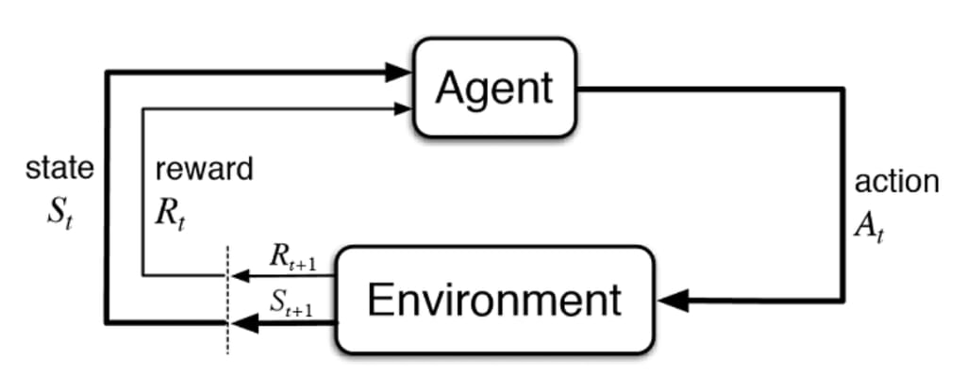
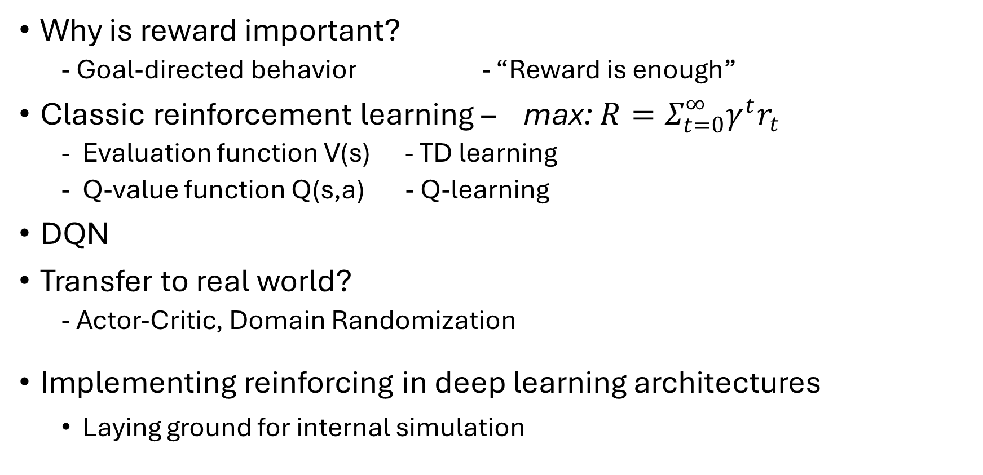
Reward mechanisms
Why is reward important?
- Goal-directed behavior - “Reward is enough”
Classic reinforcement learning – max: $R=Σ_{t=0}^{∞}γ^{t}r_{t}$
Evaluation function V(s) - TD learning
Q-value function Q(s,a) - Q-learning
DQN
Transfer to real world?
- Actor-Critic, Domain Randomization
Implementing reinforcing in deep learning architectures
Laying ground for internal simulation

Slide 9
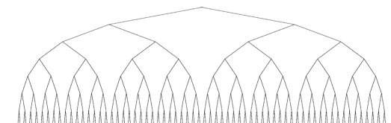
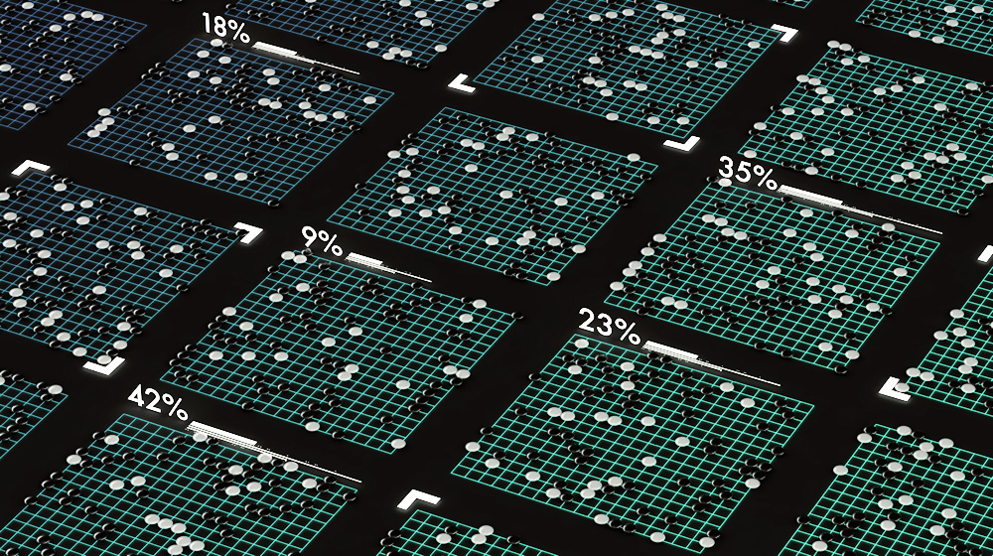
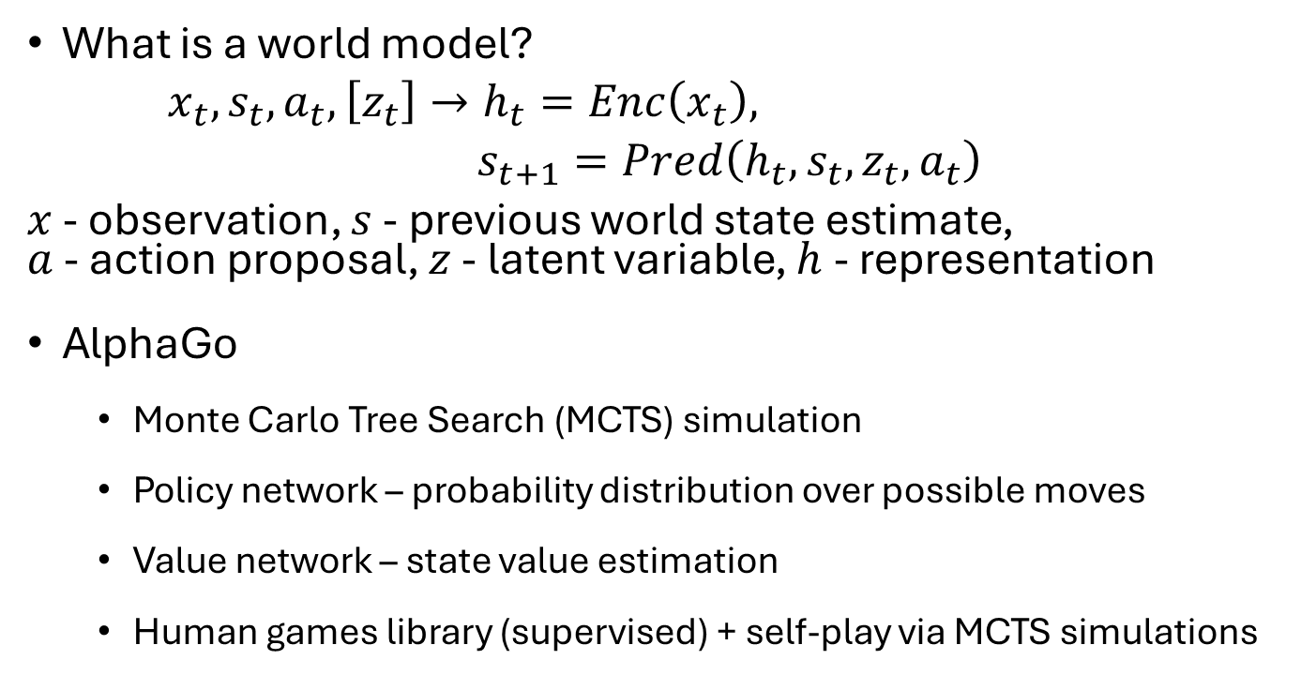
Internal Simulation and World Models
What is a world model?
$x_{t},s_{t},a_{t},\left[z_{t}\right]→h_{t}=Enc\left(x_{t}\right),$
$s_{t+1}=Pred\left(h_{t},s_{t},z_{t},a_{t}\right)$
$x$ - observation, $s$ - previous world state estimate, $a$ - action proposal, $z$ - latent variable, $h$ - representation
AlphaGo
Monte Carlo Tree Search (MCTS) simulation
Policy network – probability distribution over possible moves
Value network – state value estimation
Human games library (supervised) + self-play via MCTS simulations

Slide 10
Internal Simulation and World Models
AlphaGo Zero – Learning entirely from self-play
AlphaZero
World model of a game to learn as input (i.e., game rules)
Superhuman performance via self-play
Ha and Schmidhuber’s ‘World Models’ framework
Vision, Memory, and Controller models

Slide 11
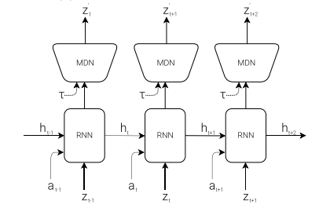
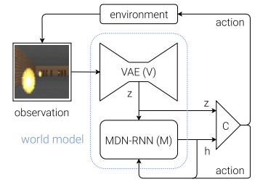
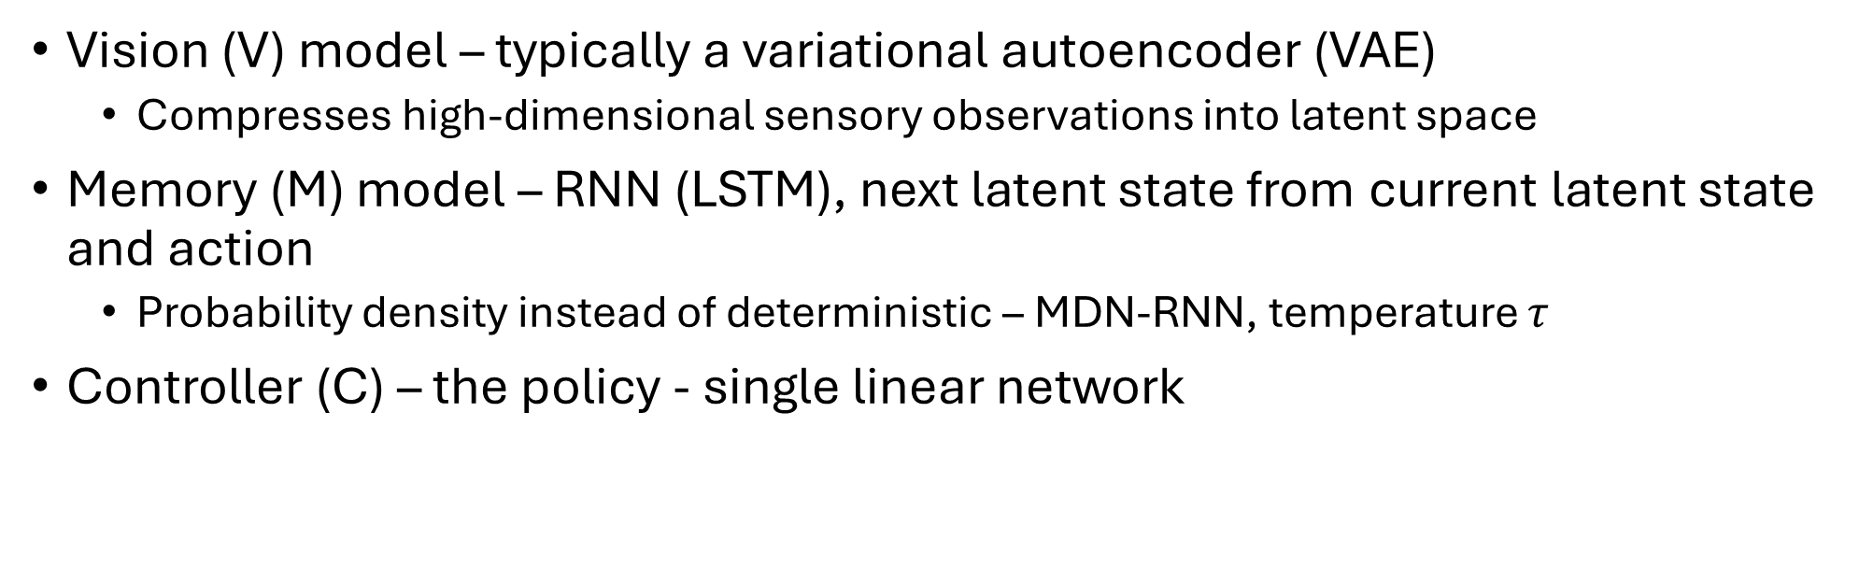
Internal Simulation and World Models
Vision (V) model – typically a variational autoencoder (VAE)
Compresses high-dimensional sensory observations into latent space
Memory (M) model – RNN (LSTM), next latent state from current latent state and action
Probability density instead of deterministic – MDN-RNN, temperature $τ$
Controller (C) – the policy - single linear network

Slide 12
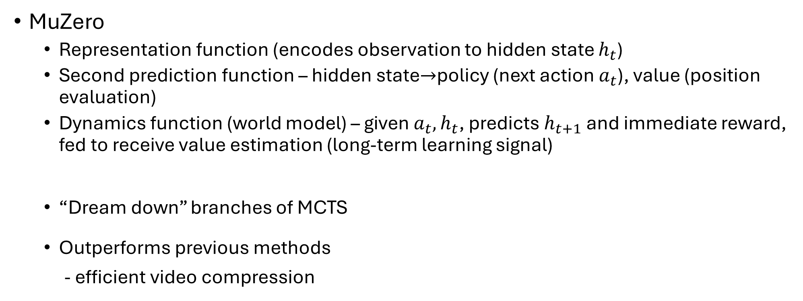
Internal Simulation and World Models
MuZero
Representation function (encodes observation to hidden state $h_{t}$)
Second prediction function – hidden state$→$policy (next action $a_{t}$), value (position evaluation)
Dynamics function (world model) – given $a_{t},h_{t}$, predicts $h_{t+1}$ and immediate reward, fed to receive value estimation (long-term learning signal)
“Dream down” branches of MCTS
Outperforms previous methods
- efficient video compression

Slide 13
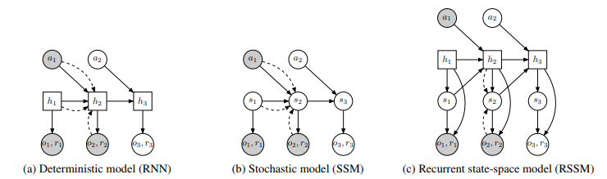
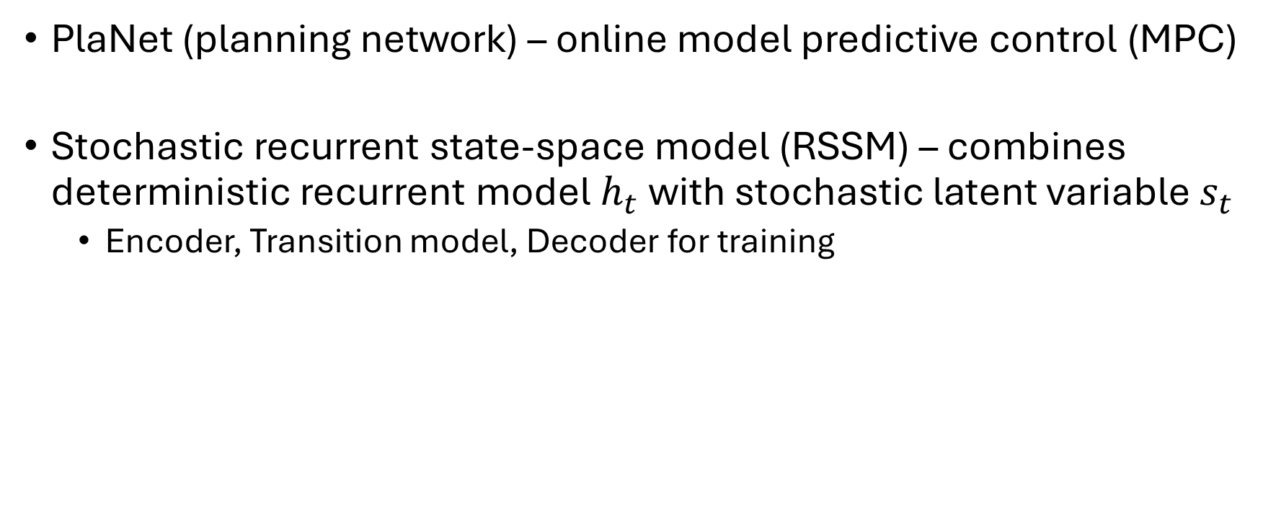
Internal Simulation and World Models
PlaNet (planning network) – online model predictive control (MPC)
Stochastic recurrent state-space model (RSSM) – combines deterministic recurrent model $h_{t}$ with stochastic latent variable $s_{t}$
Encoder, Transition model, Decoder for training

Slide 14
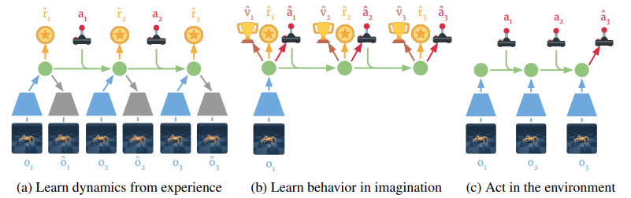
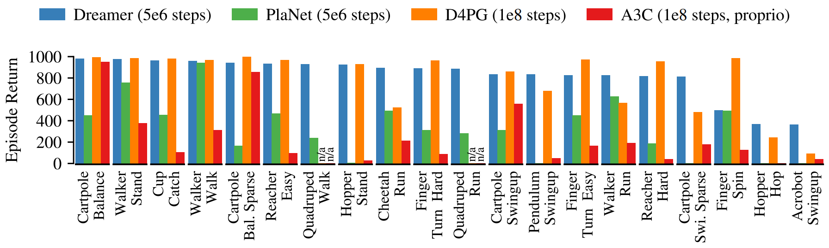
Internal Simulation and World Models
Computationally demanding, don’t fully leverage world models, shortsighted (finite imagination horizons)
Dreamer
Latent imagination
Three parallelizable processes:
World model learning (RSSM from PlaNet) - Acting in environment
Learning behavior based on world model predictions (actor-critic)

Slide 15
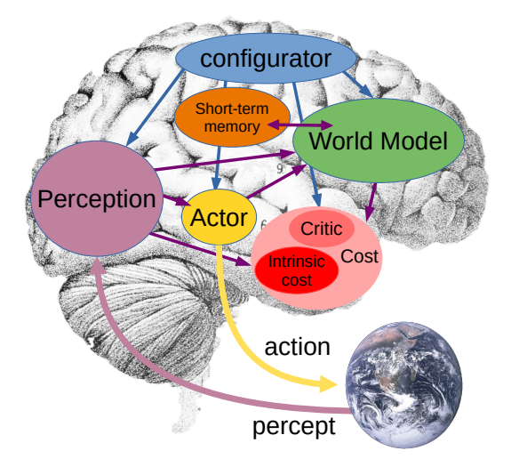
Joint Embedding Predictive Architecture (JEPA)
Motivation
Overall architecture (differentiable):
Perception module
World model module
Cost module (immutable intrinsic cost, trainable critic)
Actor module - policy, action optimizer
Configurator

Slide 16
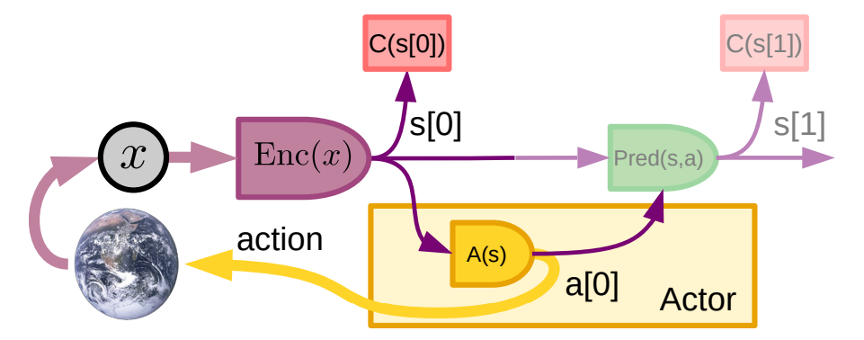
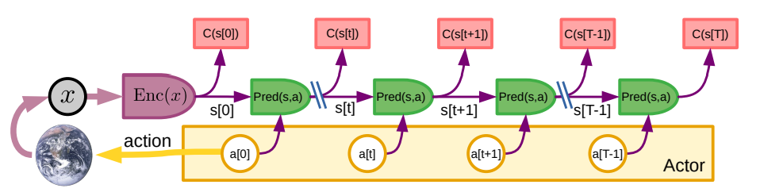
Joint Embedding Predictive Architecture (JEPA)
Perception-action loop:
Mode-1 Operation
Mode-2 Operation (MPC with learned world model)
Perception
Action sequence proposal
Simulation (one or more likely resulting world states)
Evaluation
Planning (gradient propagation)
Optimal action sequence acting
Mode-2 to Mode-1 distillation

Slide 17
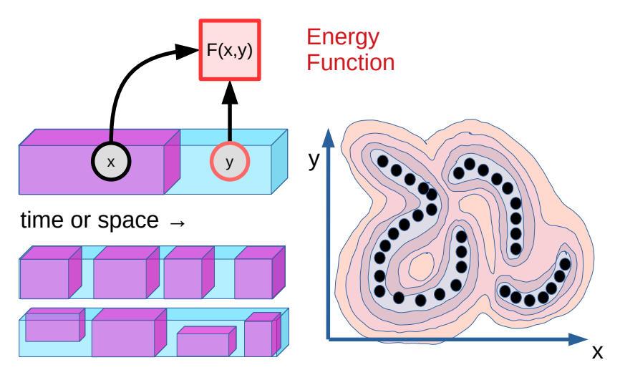
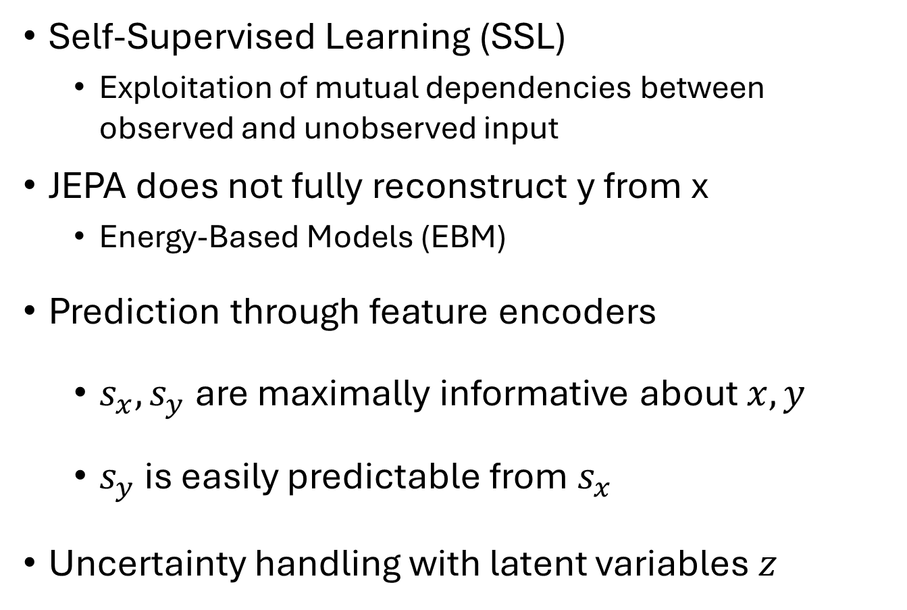
Joint Embedding Predictive Architecture (JEPA) – World model design and training
Self-Supervised Learning (SSL)
Exploitation of mutual dependencies between observed and unobserved input
JEPA does not fully reconstruct y from x
Energy-Based Models (EBM)
Prediction through feature encoders
$s_{x},s_{y}$ are maximally informative about $x,y$
$s_{y}$ is easily predictable from $s_{x}$
Uncertainty handling with latent variables $z$

Slide 18
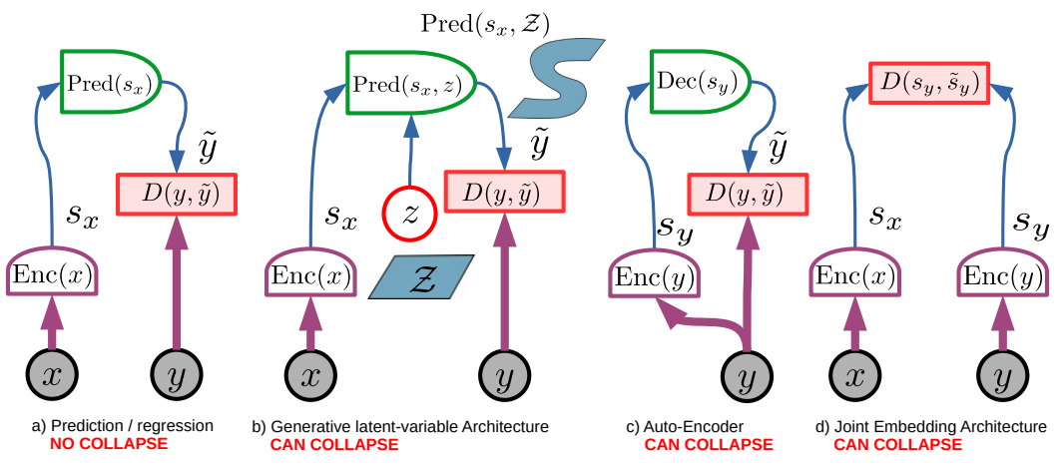
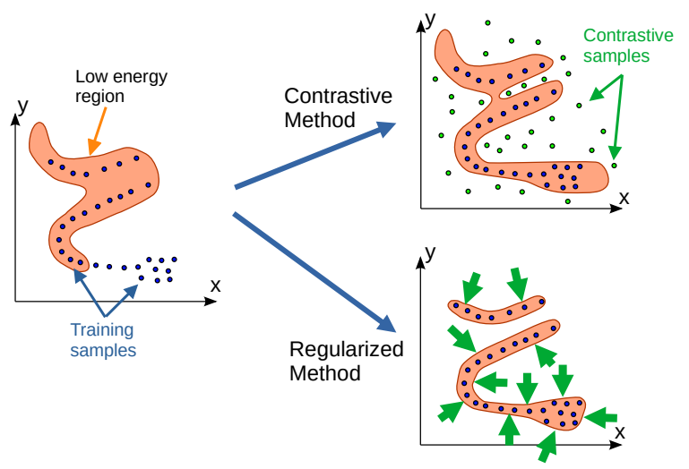
Joint Embedding Predictive Architecture (JEPA)
The problem of collapse
Collapse prevention
Contrastive methods
Regularized methods

Slide 19
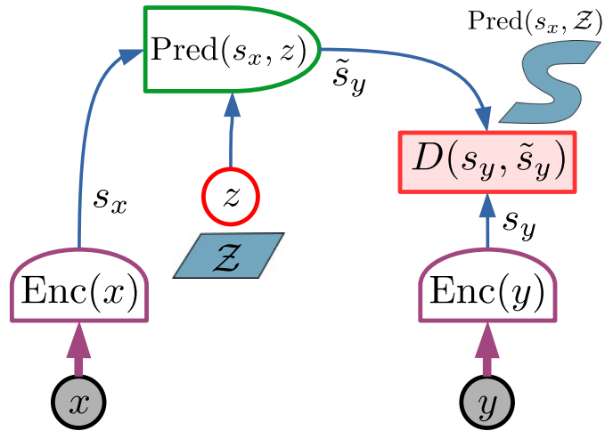
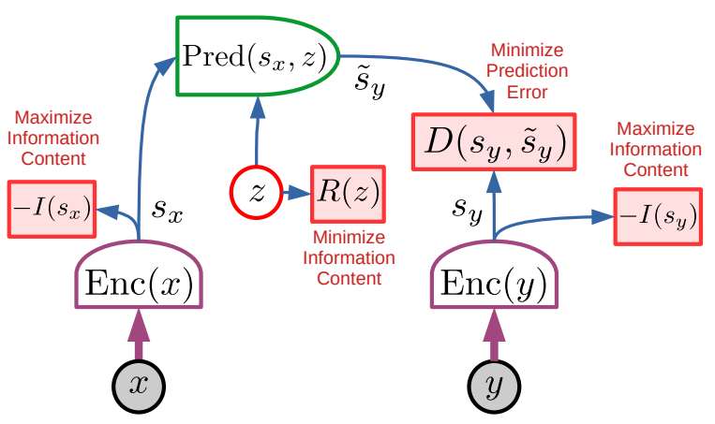
Joint Embedding Predictive Architecture (JEPA)
JEPA

Slide 20
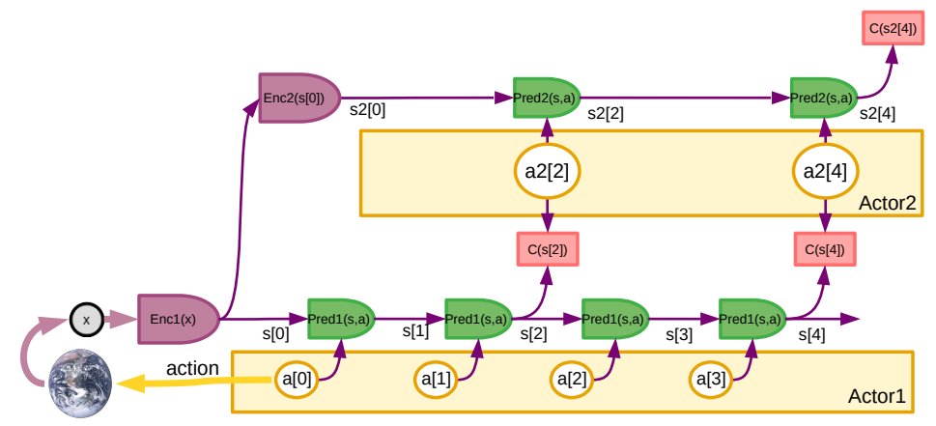
Joint Embedding Predictive Architecture (JEPA)
Hierarchical planning – H-JEPA
Complex planning task - Travelling to Paris
Book flight, get to airport…
Call taxi, exit house…
Stand up, walk to door, open the door…
…
Millisecond-by-millisecond motor control

Slide 21
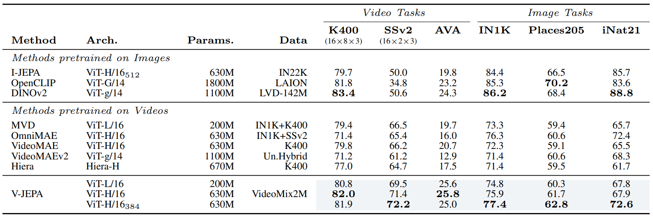
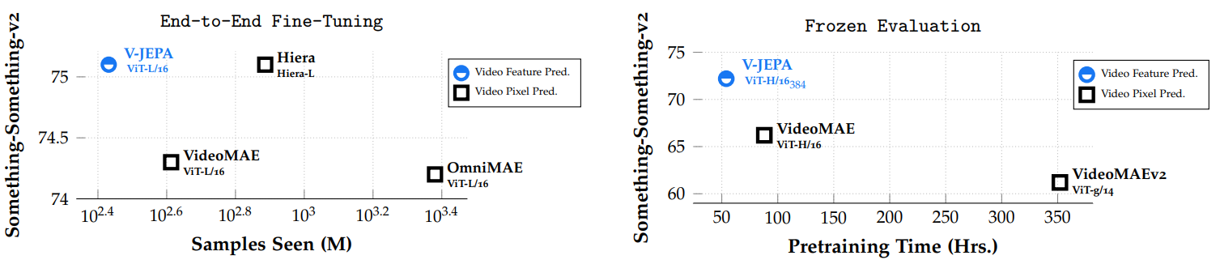
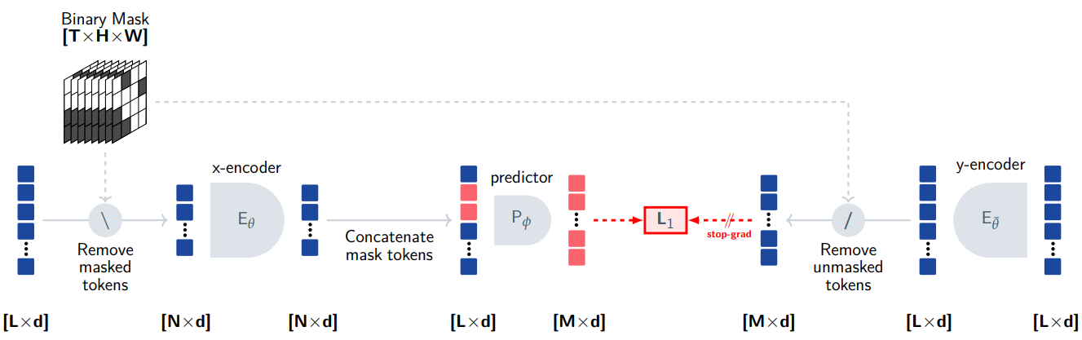
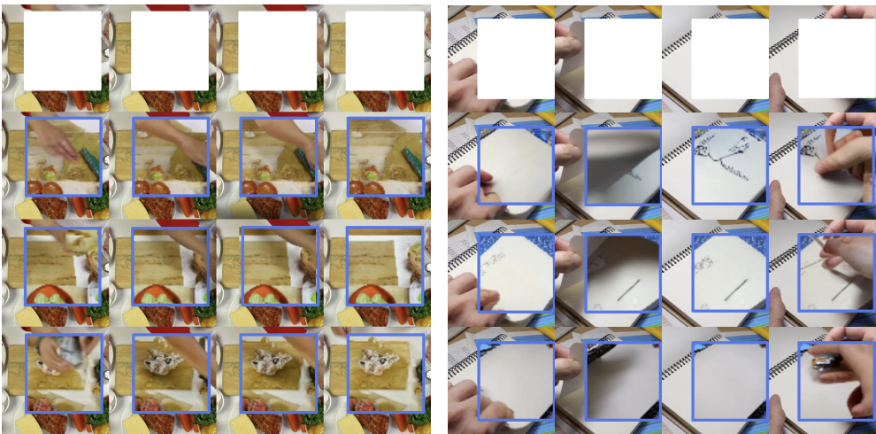
Joint Embedding Predictive Architecture (JEPA)
I-JEPA
V-JEPA

Slide 22
Joint Embedding Predictive Architecture (JEPA)
An integrated architecture
Learning “good” goals not predefined by humans
ACC Intent
Mentalization

Slide 23
Joint Embedding Predictive Architecture (JEPA)
Language in machine intelligence- discussion
Current LLMs - tokenized, latent-variable free, generative paradigms, trained using contrastive methods
Lack “grounded intelligence”
Lack search for optimal courses of action
Largely inefficient

Slide 24
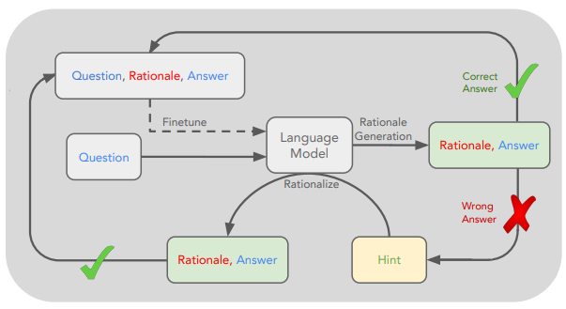
Mentalization in deep learning
STaR – special case of mentalization?
Infer intent (rationale) given observed actions and knowledge
Importance of mentalization in machine intelligence
Implementing mentalization in ml - discussion

Slide 25
Conclusion
Neuroscientific principles behind the human brain
Deep learning research
Reward mechanisms and reinforcing
Internal simulation and world models
The Joint-Embedding Predictive architecture
Proposed ideas for implementing mentalization in DL
Each foundational for its successor, as well as complementary
autonomous general machine intelligence architectures
application-specific deep learning models
physical intelligence and robots

Slide 26
תודה רבה על ההקשבה!

